Slide 1
Understanding bioinformatic basics for cancer research
Greg Gloor
Department of Biochemistry
University of Western Ontario

Slide 2
Objectives
Examine the relevance of bioinformatics to modern cancer research
Describe important bioinformatic and statistical approaches to analyzing large datasets
Discuss the limitations of bioinformatics analysis and molecular technologies

Slide 3
Relevance
Bioinformatics is a broad topic
All Biomedical Science is now computational biology
Bioinformatics helps to distill signal from noise
Biomedical science is an information science at much as it is an experimental science
Notes:
Biomedical science was information poor, experiments were difficult. Now understanding the embarrassment of riches in the data is crucial

Slide 4
Relevance
Bioinformatics is a broad topic
All Biomedical Science is now computational biology
Bioinformatics aims to distill signal from noise
Notes:
Hard-core comp sci to data analytics

Slide 5
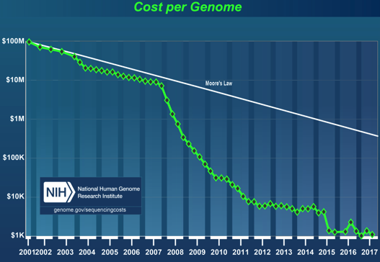
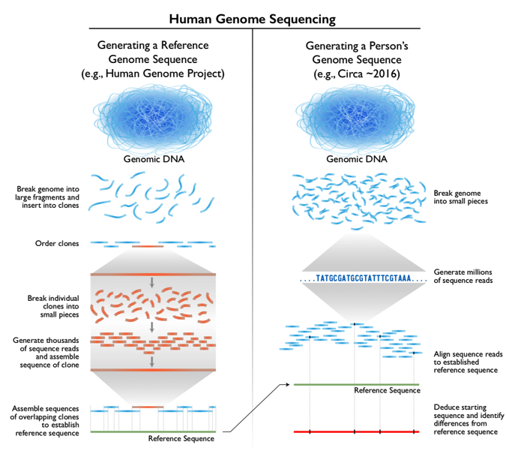
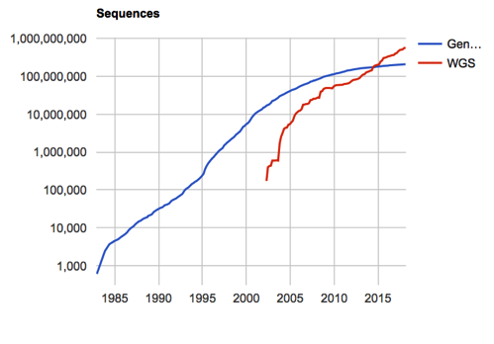
Data availability is not the problem

Slide 6

Data availability is not the problem
Notes:
Original human genome – labour at the front end, basic bioinformatic tools at the back end. Most of the work and cost was wet lab, cloning, ordering and sequencing
Human genome today: all the front-end labour is automatable. The bottleneck is the interpretation at the back end

Slide 7

Data availability is not the problem
Notes:
Data availability driven by sequencing technology
Capillary sequencing improved ~2004
Pyrosequeincg (454) ~ 2007
Short read sequencing ~ 2008, parallelization rapidly improves

Slide 8
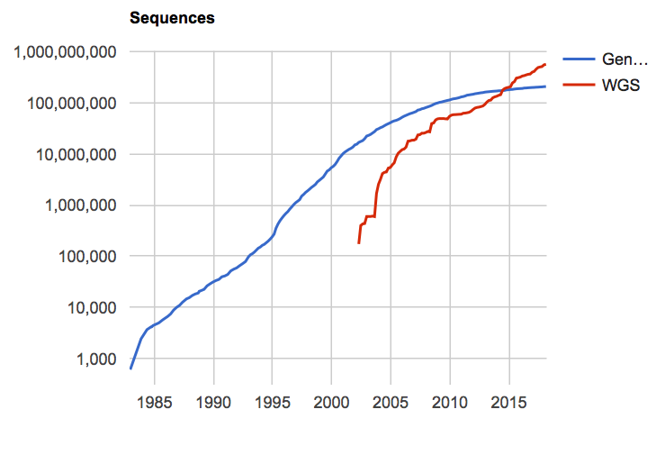
Data availability is not the problem
Notes:
Sequences were rare before DNA sequencing, but accumulated exponentially afterward
WGS, high throughput is the major source today, and there is not enough space to store it all
Early, every nt was hand curated, late every nucleotide algorithmically examined

Slide 9
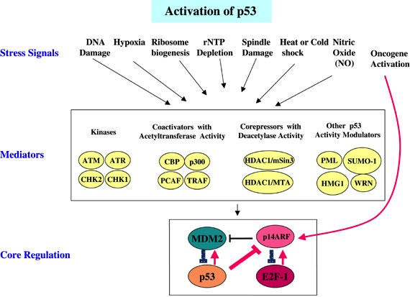
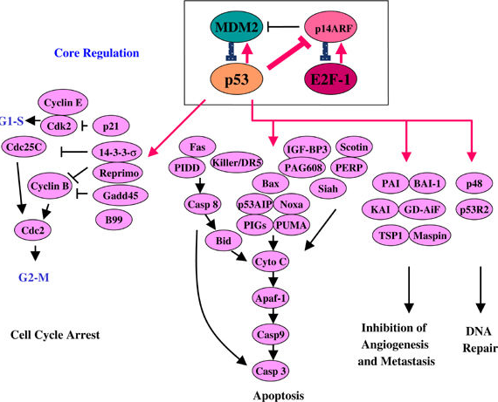
One little pathway
Important in ovarian cancer
Not the only pathway
Many (most?) ovarian cancers have private sequence variants
Copy number variation and other large-scale changes common
The p53 pathway: positive and negative feedback loops, Oncogene 2005
Notes:
Even one little pathway has an unimaginal amount of information. Who is there (just the sequence), what are the connections (network analysis), what do the connections do and can we determine emergent properties from first principles (systems biology), how does perturbations of the system cause/protect from cancer and other disease?

Slide 10
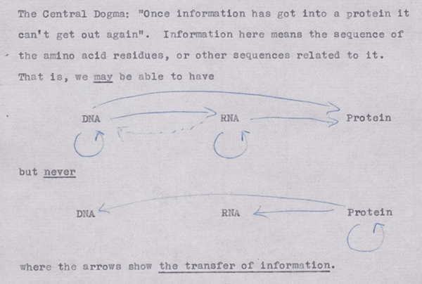
Central Dogma
Cobb M (2017) 60 years ago, Francis Crick changed the logic of biology. PLOS Biology 15(9): e2003243. https://doi.org/10.1371/journal.pbio.2003243
http://journals.plos.org/plosbiology/article?id=10.1371/journal.pbio.2003243

Slide 11
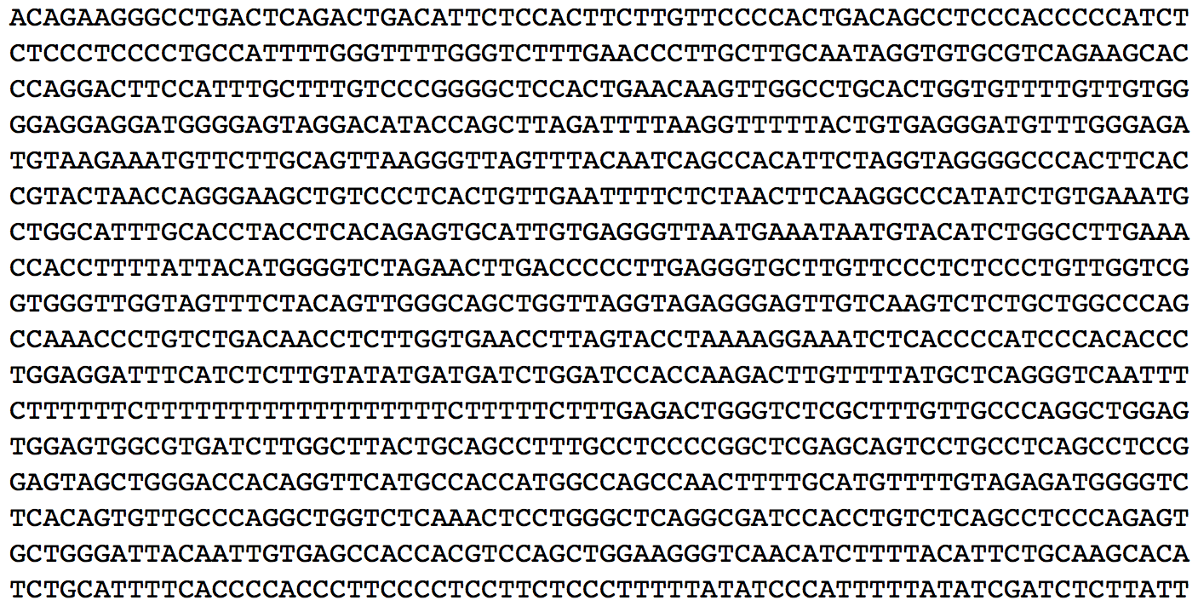
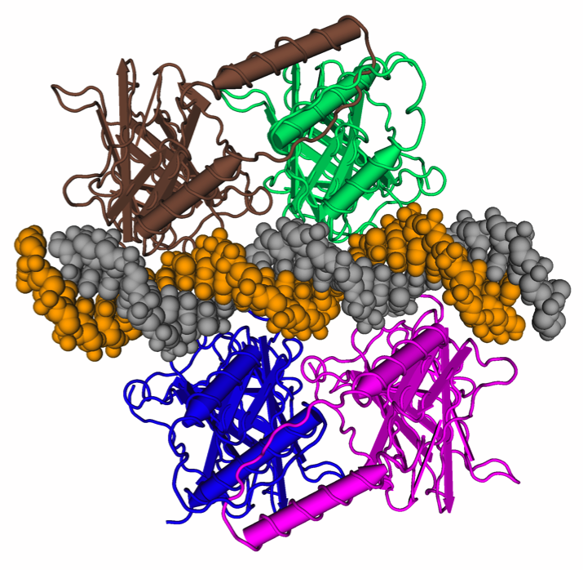
We are drowning in a sea of data
>P53 [Homo sapiens]
MEEPQSDPSVEPPLSQETFSDLWKLLPENNVLSPLPSQAMDDLMLSPDDIEQWFTEDPGPDEAPRMPEAA
PRVAPAPAAPTPAAPAPAPSWPLSSSVPSQKTYQGSYGFRLGFLHSGTAKSVTCTYSPALNKMFCQLAKT
CPVQLWVDSTPPPGTRVRAMAIYKQSQHMTEVVRRCPHHERCSDSDGLAPPQHLIRVEGNLRVEYLDDRN
TFRHSVVVPYEPPEVGSDCTTIHYNYMCNSSCMGGMNRRPILTIITLEDSSGNLLGRNSFEVHVCACPGR
DRRTEEENLRKKGEPHHELPPGSTKRALSNNTSSSPQPKKKPLDGEYFTLQIRGRERFEMFRELNEALEL
KDAQAGKEPGGSRAHSSHLKSKKGQSTSRHKKLMFKTEGPDSD
Notes:
Data is at many levels with complexity

Slide 12
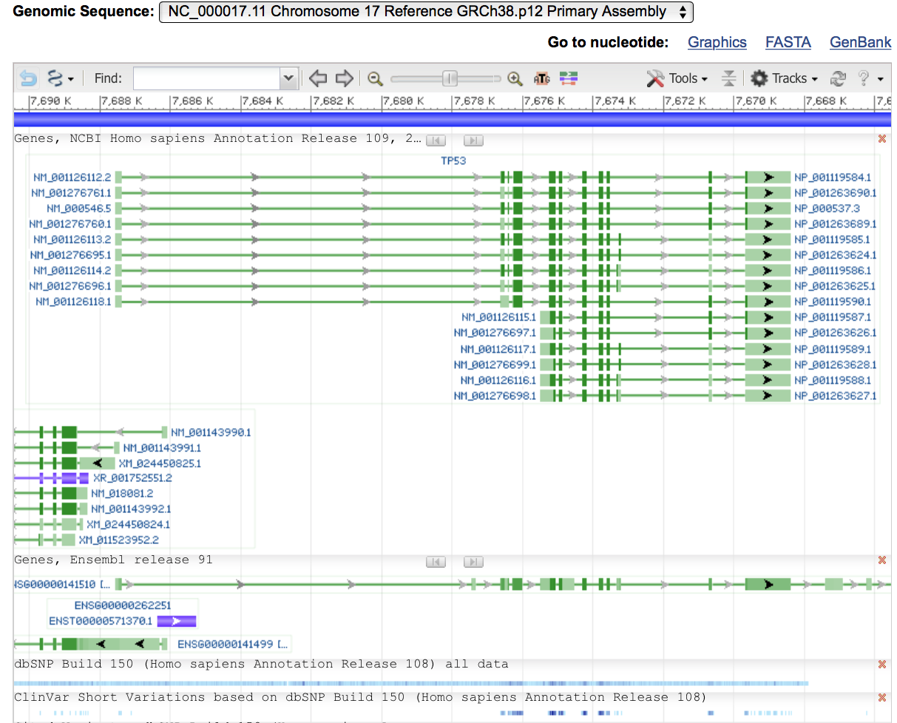
Bioinformatics brings order
Notes:
Genome sequence representation
Genome in purple top
Exon-intron structure below (this is determined by RNA-sequencing, not by imputation)
Bioinformatics uses all this information to inform regarding clinical significance
Cannonical gene (ENSEMBLE)
Snps
Clinical variants

Slide 13
Important approaches
Databases
Public, private, proprietary, clinical
Sequence analysis
DNA, RNA, protein
Variant classification
Known and de novo
Network analysis
Systems Biology

Slide 14
Variants in Cancer
Collect sample
Make library
Sequence
Map to genome
Identify variants
Classify by effect
Report
Standards and Guidelines for the Interpretation and Reporting of Sequence Variants in Cancer J. Mol Diag 2017
Notes:
Variant calling in cancer tissue is very difficult problem compare to mendelian

Slide 15
Map to genome
Mapping is not a time issue
Which tool is not obvious
BWA, Maq, Bowtie, STAR, NovoAlign, BLAT
Algorithmic strategies differ

Slide 16
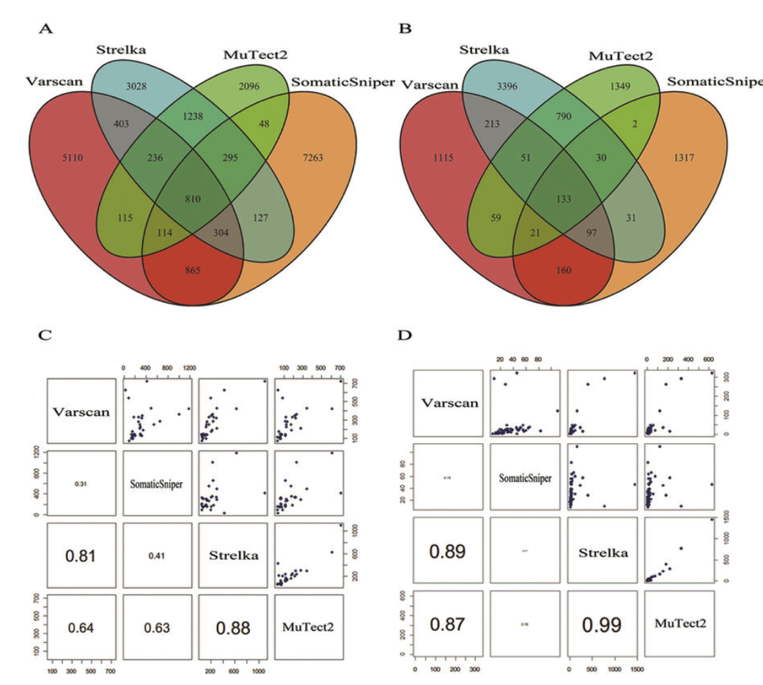
Identify variants
Varscan
Strelka
MuTect2
SomaticSniper
In-depth comparison of somatic point mutation callers based on different tumor next-generation sequencing depth data Sci Rep 2017

Slide 17
Classify by effect
Standards and Guidelines for the Interpretation and Reporting of Sequence Variants in Cancer J. Mol Diag 2017
Notes:
Evidence-based variant categorization. Somatic variants are classified into four tiers based on their level of clinical significance in cancer diagnosis, prognosis, and/or therapeutics. Variants in tier I are of strongest clinical significance, and variants in tier IV are benign or likely benign variants. FDA, Food and Drug Administration.

Slide 18
Databases

Slide 19
Classify by effect
Standards and Guidelines for the Interpretation and Reporting of Sequence Variants in Cancer J. Mol Diag 2017
Notes:
Evidence-based variant categorization. Somatic variants are classified into four tiers based on their level of clinical significance in cancer diagnosis, prognosis, and/or therapeutics. Variants in tier I are of strongest clinical significance, and variants in tier IV are benign or likely benign variants. FDA, Food and Drug Administration.

Slide 20
Tier 3 prediction tools

Slide 21
Network Analysis
Hoadley Cell 2018

Slide 22
Groups correlate with drug targets

Slide 23
Systems Biology

Slide 24
PARP cleavage modelling
Korunsky Front Biotech Bioengg 2014

Slide 25
Limitations
Large genomic studies have therefore found their way into high impact journals in part due to their bulk of new data, even though the analysis within these papers can often re-affirm what is already known about the disease, without improving cancer treatment. New ideas and strategies which transcend data collection must be pursued if biology-based therapies are to reduce cancer deaths beyond what epidemiology and preventative measures have already succeeded in. There is reason to believe the genomic data we need to improve the treatment of ovarian cancer already exists.
Pathways to Genome-Targeted Therapies in Serous Ovarian Cancer J. Nat Sci 2017

Slide 26
Limitations: Standard of truth
Do we have one?
Can we model properly?

Slide 27
Limitations: DB issues
What is the purpose/content/validation?
What are the limitations of the information?
What version of the data is the DB built on?
What is the co-ordinate system?
Journal of Molecular Diagnostics 2017

Slide 28
Limitations: Algorithms
Different algorithms give different results on different datasets
Potentially unlimited combinations to test
Imperfect knowledge of system
What is important?
Time? Precision? Recall? Ease of use? Features?

Slide 29
Limitations: Analysis
Bioinformatics costs!
2013: $5150/patient (seq 15200)
2015: $5575/patient (seq $14800)
2017: $5k/patient (seq $2000)
Majority of future costs will continue to be bioinformatic-related
Rapidly changing standards and methods
Difficult/impossible to standardize now
Even minor technology changes affect output
Bioinformatics methods vary by method, by platform and by experimental design
The cost and cost trajectory of whole-genome analysis guiding treatment of patients with advanced cancers, Mol Gen Genom. Med. (2017)
http://massgenomics.org/2015/10/ngs-analysis-not-free.html

Slide 30
Limitations: Communication

Slide 31

Limitations: Communication

Slide 32


Limitations: Communication

Slide 33
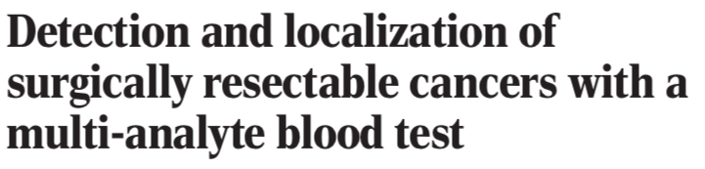
CancerSEEK
What did bioinformatics contribute and how?
Targets
Gene/Genome sequences
Allele frequencies
Protein homology
Analysis of the outputs
DNA sequence
Mass Spec
Optimized algorithms
Cohen Science 2018:359:926
Notes:
Identification of cancer type by supervised machine learning for patients classified as positive by CancerSEEK. Percentages correspond to the proportion of patients correctly classified by one of the two most likely types (sum of light and dark blue bars) or the most likely type (light blue bar). Predictions for all patients for all cancer types are provided in table S8. Error bars represent 95% confidence intervals.

Slide 34
Screening algorithm

Slide 35
Screening utility
Notes:
Sensitivity is nice, but specificity if crucial to screening for rare events

Slide 36
Diagnostic utility
Notes:
Sensitivity is nice, but specificity if crucial to screening for rare events

Slide 37
Summary
Biomedical sciences are information-rich sciences
We need bioinformatics to bring order from chaos
The lack of a standard of truth is limiting
All tools have flaws, we just don’t know what they are
Collectively we need to communicate and collaborate outside our comfort zones

